Slide 1

Applied Text Analytics ( F20/F21AA ) Heriot Watt University , Dubai Campus
Dr. Neamat El Gayar

Slide 2
Recap :Text representation (bag of words)
Most simple but effective and commonly used ways to represent text for machine learning is using the bag-of-words representation.
Each document is represented as a vector. ( Vector space model)
One dimension for every unique term in space
Discards most of the structure of the input text, like chapters, paragraphs, sentences, and formatting, and only count how often each word appears in each text

Slide 3
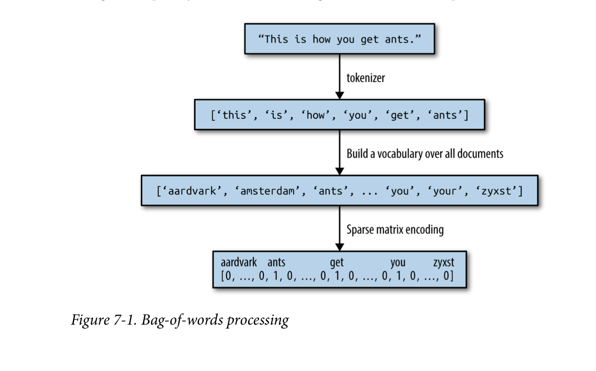
Recap: Bag of word representation

Slide 4
Recap: Bag of words model
Doesn’t consider the ordering of words in a document ( still works well for many applications like classification and topic modelling)
Applications on language generation and sentiment analysis require more of capturing the meaning
So: The order of words provides ‘semantic’ meaning. Therefore we will also study how to represent context/analogy/similarity & how to represent ‘ text as a set of sequence’ [ More related to NLP ]
Notes:
We are not keeping track of positions
Bag= contains duplicate items
Set = no duplicate items
“The models we have seen in this book so far use a bag-of-words decomposition technique, enabling us to explore relationships between documents that contain the same mixture of individual words. This is incredibly useful, and indeed we’ve seen that the frequency of tokens can be very effective particularly in cases where the vocabulary of a specific discipline or topic is sufficient to distinguish it from or relate it to other text.”

Slide 5
Context Aware Analysis
We did not consider the context in which the words appear, which we instinctively know plays a huge role in conveying meaning.
Lower performing models can often be significantly improved with the addition of contextual feature extraction
Classic NLP models use ‘Language based features’ (POS – NER,…)

Slide 6
Today's Lecture
Representing meaning in word vectors:
Word embeddings
( also called word vectors – distributed word representations)
Count based models
Word2vec (developed by google) – Skip gram –Negative sampling
GloVe (developed by Stanford)
Notes:
Word2vec based on context ( CBOW and Skipgrams)

Slide 7
Recap (Document Vectorization)
Representing documents as vectors

Slide 8
Document Vectorization
Document is represented with a numerical vector
Dimension of the vector =distinct terms in ”corpus”
Method | Function | Description | Comments
Binary “One-hot” | 0 1 | 1 if term occurs 0 otherwise | Can be suitable for shorter documents and NN implementations
Frequency | TF | Counts frequency of terms | Works well for k-means clustering and some probabilistic methods
Term Frequency Inverse Document Frequency | TF-IDF | Weights term by importance across corpus | Originally the gold- standard of Information retrieval
Can use N-gram features
Can be used in combination with PCA for dimensionality reduction
Notes:
Careful when using different types of normalization and pre-processing methods.
What works for one application domain might not work for another
Example: information retrieval settings vrs social network analysis

Slide 9
Encoding Words
Representing words as vectors

Slide 10
Reminder: Term-document matrix
Each cell: count of term t in a document d: tf_{t,d}:
Each document is a count vector in ℕ^{v}: a column below

Slide 11
Reminder: Term-document matrix
Two documents are similar if their vectors are similar

Slide 12
The words in a term-document matrix
Each word is a count vector in ℕ^{D}: a row below
Notes:
For documents, we saw that similar documents had similar vectors, because sim- ilar documents tend to have similar words. This same principle applies to words: similar words have similar vectors because they tend to occur in similar documents. The term-document matrix thus lets us represent the meaning of a word by the doc- uments it tends to occur in.

Slide 13
The words in a term-document matrix
Two words are similar if their vectors are similar

Slide 14
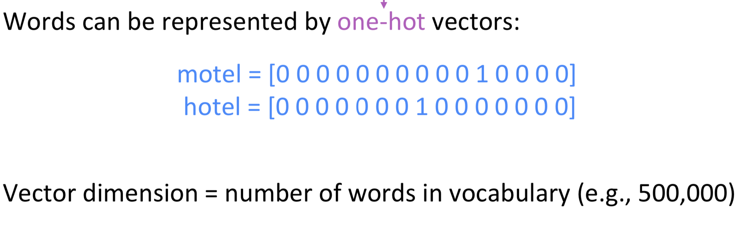
Hot one encoding
The most significant weakness of this representation is that each word is treated as a thing by itself and there is nothing that can help generalize and create an analogy reasoning.
Big drawback because in natural language processing making analogies to predict a word is crucial.
Notes:
Away from one-hot encoding…Another way to transform text or word to vectors (numbers) is called Word Embedding.
Infinite space of words
Another problem, how can you encode the similarity between ‘motel’ & ‘hotel’
Could try to rely on WordNet’s list of synonyms to get similarity? • But it is well-known to fail badly: incompleteness, etc.
Instead: learn to encode similarity in the vectors themselves

Slide 15
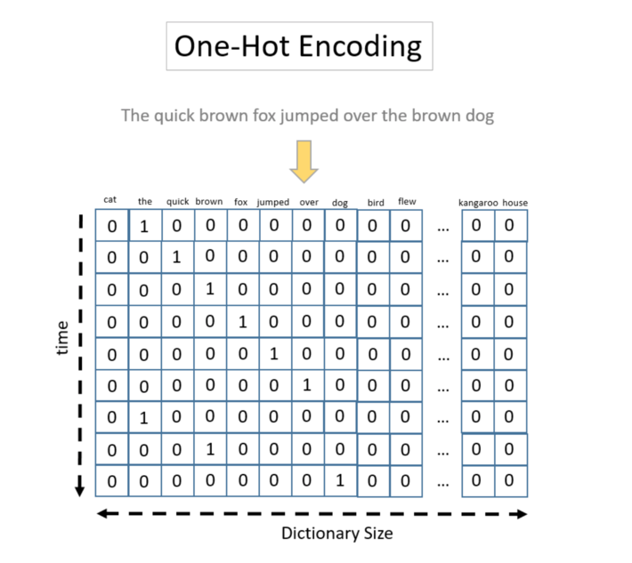
Word encoding
The hot one encoding of a word is fed into the Sequence model
(very long sequence of 0 & 1 )
Vocabulary size can be 500 000
(high-dimensional, sparse representation)
This representation does not encode any similarities
Word-embeddings:
represent words in a low-dimensional , dense representation
Words with similar meaning have similar representation
are building blocks of Neural & Deep Learning models

Slide 16
Encoding Words while capturing similarity
Representing words as vectors

Slide 17
Word similarity
Words that occur in similar contexts tend to have similar meanings.
Example synonyms (like oculist and eye-doctor) occur in the same ‘context’ …..near words like eye or examined
Representations of the meaning of words (called embeddings ) can be learned directly from their distributions in texts “instead of creating representations by hand via feature engineering “
Modelling word meaning should allow us to draw useful inferences that are useful in meaning-related tasks like question-answering, summarization, detecting paraphrases or plagiarism, and dialogue.

Slide 18
Any one knows the meaning of ‘oncgchoi’?
You observe it appears in sentences/contexts like:
Ongchoi is delicious sauteed with garlic
Ongchoi is superb over rice.
...ongchoi leaves with salty sauces...

Slide 19
Any one knows the meaning of ‘oncgchoi’?
You observe it appears in sentences/contexts like:
Ongchoi is delicious sauteed with garlic
Ongchoi is superb over rice.
...ongchoi leaves with salty sauces...
Context words appear in text like:
...spinach sauteed with garlic over rice...
...chard stems and leaves are delicious...
...collard greens and other salty leafy greens
Notes:
The fact that ongchoi occurs with words like rice and garlic and delicious and
salty, as do words like spinach, chard, and collard greens might suggest to the reader that ongchoi is a leafy green similar to these other leafy greens

Slide 20
Any one knows the meaning of ‘oncgchoi’?
words that occur in very similar distributions (i.e. occur together with very similar words) are likely to have the same meaning.
Ongchoi is a leafy green like spinach, chard, or collard greens
We could conclude this based on on words like "leaves" and "delicious" and "sauteed"

Slide 21
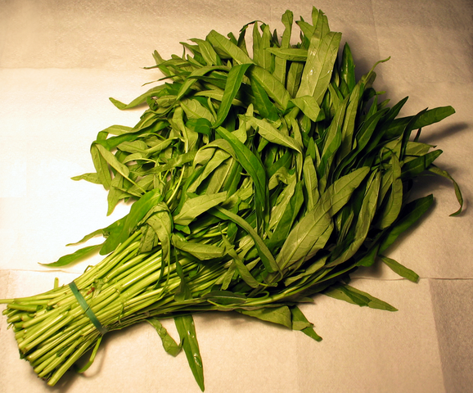
Ongchoi: Ipomoea aquatica "Water Spinach"
空心菜
kangkong
rau muống
…
Yamaguchi, Wikimedia Commons, public domain
Notes:
Here's a picture of ongchoi for you food fans

Slide 22
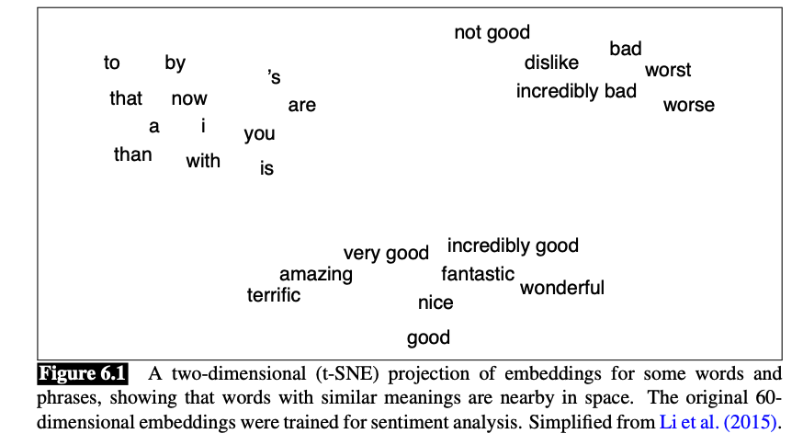
Vector Semantics
Notes:
shows a visualization of embeddings learned for sentiment analysis,
showing the location of selected words projected down from 60-dimensional space
into a two dimensional space. Notice the distinct regions containing positive words,
negative words, and neutral function words.

Slide 23
Words as vectors: Term-Context matrix ( term-term matrix – word-word matrix)
Instead of using entire documents, use smaller contexts
Paragraph
Window of 10 words
A word is now defined by a vector over counts of context words

Slide 24
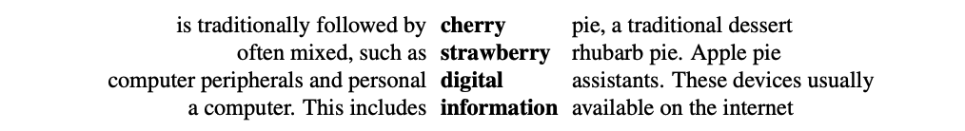
Example p. 9 (Ch 6*)
matrix is of dimensionality |V | × |V | and each cell records the number of times the row (target) word and the column (context) word co-occur in some context in some training corpus.
Here context= 4 words to the left and 4 words to the right
Example of window around target word (Wikipedia corpus) :
*Chapter 6: Vector Semantics and Embeddings , Speech and Language Processing, Jurafsky&Martin, 2020

Slide 25
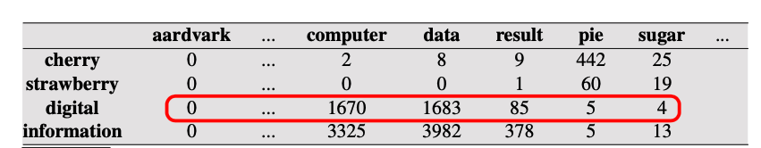
Co-occurrence vector
Two words are similar in meaning if their context vectors are similar
Note: the real vector has vastly more dimensions and thus be much sparser.
Notes:
Co-occurrence vectors for four words in the Wikipedia corpus, showing six of the dimensions (hand-picked for pedagogical purposes). The vector for digital is outlined in red. Note that a real vector would have vastly more dimensions and thus be much sparser. the two words cherry and strawberry are more similar to each other (both pie and sugar tend to occur in their window) than they are to other words like digital

Slide 26
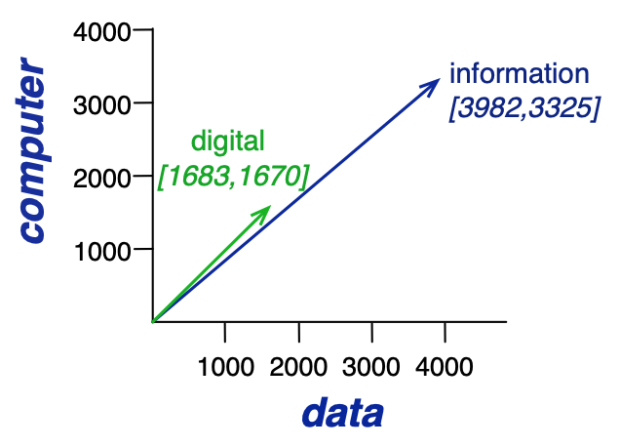
Co-occurrence vector
Two words are similar in meaning if their context vectors are similar
Note: the real vector has vastly more dimensions and thus be much sparser.
Notes:
. the two words cherry and strawberry are more similar to each other (both pie and sugar tend to occur in their window) than they are to other words like digital
conversely, digital and information are more similar to each other than, say, to strawberry.

Slide 27
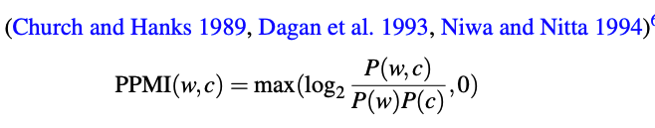
Should we use raw counts?
For the term-document matrix
We used tf-idf instead of raw term counts
For the term-context matrix
Positive Pointwise Mutual Information (PPMI) is common.
PMI= estimate of how much more the two words co-occur than we expect by chance.
PPMI –replaces negative PMI by zero ( for better interprability)
Notes:
Raw frequency is very skewed and not very discriminative. If we want to know what kinds of contexts are shared by cherry and strawberry but not by digital and information, we’re not going to get good discrimination from words like the, it, or they, which occur frequently with all sorts of words and aren’t informative about any particular word. We saw this also in (Shakespeare example) corpus; the dimension for the word good is not very discriminative between plays; good is simply a frequent word and has roughly equivalent high frequencies in each of the plays.
- tf-idf weighting, usually used when the dimensions are documents.
- PPMI algorithm (usually used when the dimensions are words)

Slide 28
p(w=information,c=data) =
p(w=information) =
p(c=data) =
3982/11716
= .3399
7703/11716
= .6575
5673/11716
= .4842
pmi(information,data) =
= log₂ (.3399 /(.6575*.4842) )
= .0944

Slide 29
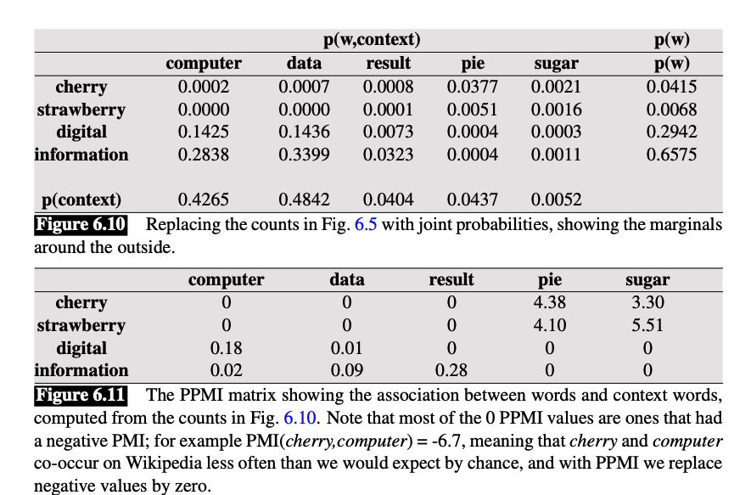
Example ch6* ( p. 17)
*Chapter 6: Vector Semantics and Embeddings ,
Speech and Language Processing, Jurafsky&Martin, 2020

Slide 30
To summarize
Vector semantic models fall into two classes: sparse and dense.
In sparse models each dimension corresponds to a word in the vocabulary V; cells in sparse models are functions of co-occurrence counts.
The most widely used sparse weighting is tf-idf. (more usual for term-document matrix)
PPMI (pointwise positive mutual information) is an alternative weighting scheme to tf-idf. (more for term-context/word matrix)
Dense vector models have dimensionality 50–1000 and the dimensions are harder to interpret.
Now we want to focus on dense vectors: Word2vec algorithms like skip-gram

Slide 31
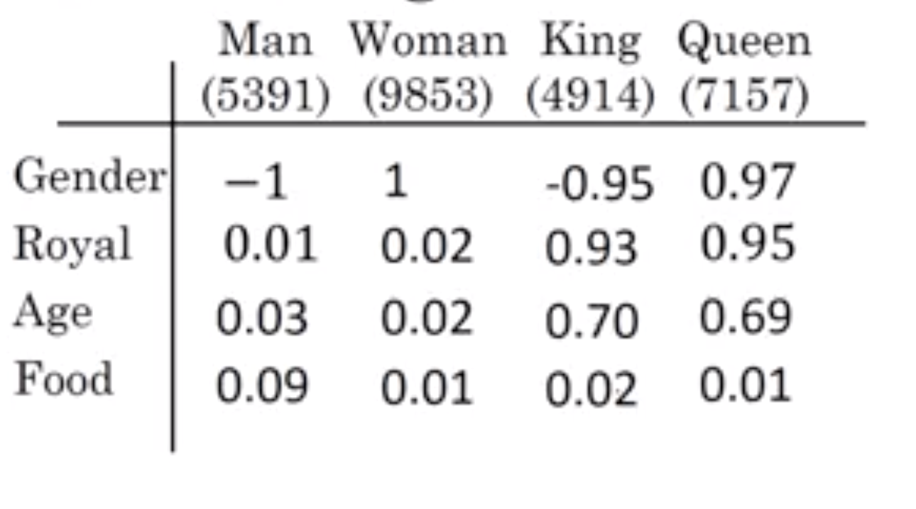
Word Embedding (capturing relational meaning)
similarity function for inferring analogy reasoning is the “cosine similarity”,
Most popular techniques:
Word2vec (developed by google)
GloVe (developed by Stanford)
FastText (Facebook)
Notes:
For example, the word “woman” was word number 5678 in the dictionary, and the one-hot representation was a vector of zeros with a 1 in the 5678th position.
https://www.kdnuggets.com/2016/05/amazing-power-word-vectors.html
man woman king queen gender -1 1 -0.95 0.97 1.05 0.08 royal 0.01 0.02 0.93 0.95 0.94 -0.01 age 0.03 0.02 0.7 0.69 0.69 0 food 0.09 0.01 0.02 0.01 -0.06 -0.07

Slide 32
Idea of Word Embeddings
Create a feature representation of every word. Therefore it allows a correlation among words.
Capture semantics , similarity and context through vector representation (capture relationships)
Representation in low dimensional, dense representation
Vectors become more meaningful -→ rich representation
Each word is a vector of a certain dimension, which represents some aspect.

Slide 33
Why we are studying this now?
They highly improved NLP/text analytic system capabilities/performance
Word Embeddings are building blocks of Neural & Deep Learning models
You can use pretrained word-embeddings if you have less data (transfer learning)
On their own they can be used for clustering and data visualization for data analysis (later example)
Many interesting properties
Notes:
In case you have a small training dataset, you can take a pre-trained embeddings and use transfer learning to transfer the embeddings to the new task. Finally, you can fine-tune the word embeddings using the small dataset you have at hands.

Slide 34
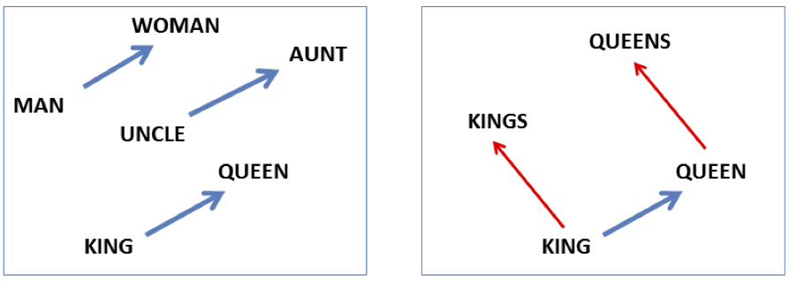
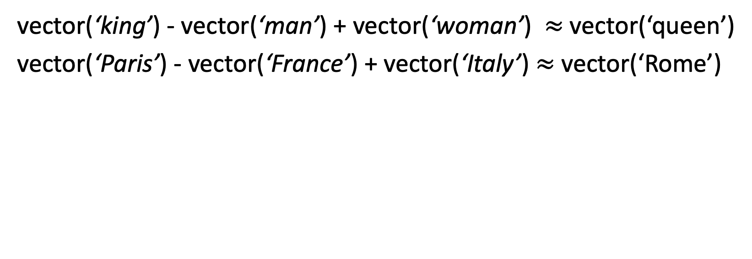
Analogy: Embeddings capture relational meaning!
vector(‘king’) - vector(‘man’) + vector(‘woman’) $≈$vector(‘queen’)
vector(‘Paris’) - vector(‘France’) + vector(‘Italy’) $≈$ vector(‘Rome’)
Notes:
Most common example of meaning in this rep

Slide 35
The amazing power of word vectors
https://www.kdnuggets.com/2016/05/amazing-power-word-vectors.html

Slide 36
Word2Vec

Slide 37
Word2vec
We will build a dense vector for each word, chosen so that it is similar to vectors of words that appear in similar contexts
Word2vec: a popular Word Embedding model & had the biggest impact that turned the world of NLP into the direction of Neural Networks & Deep Learning.
It was introduced in 2013 by team of researchers led by Thomas Mikolov at Google - Read the paper here.
Notes:
rs2Dim 50-1000 opposed to 500 000
Show a figure of dim-space and show that there is a meaning for each dimension space

Slide 38
Word2vec
(Mikolov et al. 2013) [is a framework for learning word vectors ]
Popular embedding method
Very fast to train
Code available on the web
Idea: predict rather than count
Feature space embeds words similarity
mapping to that representation is learned.
Notes:
rs2Dim 50-1000 opposed to 500 000
Show a figure of dim-space and show that there is a meaning for each dimension space

Slide 39
Word2vec (how it works)
Its input is a text corpus and its output is a set of vectors: feature vectors for words in that corpus. Given a a large corpus of text ( up to 1–100 billion words of unlabeled texts)
Go through each position i in the text, which has a target word t and context words c.
Use the similarity of the word vectors for t and c to calculate the probability of c given t (or vice versa)
Keep adjusting the word vectors to maximize this probability
Notes:
Every word in a fixed vocabulary is represented by a vector

Slide 40
Word2vec
Word2vec is a prediction based model rather than frequency.
It uses predictive analysis to make a weighted guess of a word co-occurring with respect to it’s neighbouring words.
There are 2 variants to this model:
CBOW (Continuous Bag of Words): This model tries to predict a word on bases of it’s neighbours.
SkipGram: This models tries to predict the neighbours of a word.
Notes:
CBOW tends to find the probability of a word occurring in a neighbourhood (context). So it generalises over all the different contexts in which a word can be used. Whereas SkipGram tends to learn the different contexts separately. So SkipGram needs enough data w.r.t. each context. Hence SkipGram requires more data to train, also SkipGram (given enough data) contains more knowledge about the context.

Slide 41
Word2vec
The word2vec algorithm trains word representations based on either a continuous bag-of-words (CBOW) or skip-gram model, such that words are embedded in space along with similar words based on their context
This is more effective than a bag-of-words or bag-of-n-grams model because it generalizes better and has a lower dimensionality but still is of a fixed length so it can be used in common machine learning algorithms.
Notes:
CBOW tends to find the probability of a word occurring in a neighbourhood (context). So it generalises over all the different contexts in which a word can be used. Whereas SkipGram tends to learn the different contexts separately. So SkipGram needs enough data w.r.t. each context. Hence SkipGram requires more data to train, also SkipGram (given enough data) contains more knowledge about the context.

Slide 42
(CBOW) vs. skip-gram model
The cat ate the hat
CBOW
Input (context words)
Output (centre/target word) ate
Skip-gram
Input (centre/target word) ate
Output (context words)

Slide 43
Skip-gram model ( with negative sampling)
We studied bi-grams, tri-grams to capture context
Skip-gram model, one is allowed to skip at most k tokens while predicting the context
Example of pair of similar sentences:
Adam and Eve ate an apple.
Adam ate the red apple.
Notes:
“n the skip-gram model, one predicts the context C from the target word w, whereas in the continuous bag of words, one predicts the target word w, given the context. These types of predictive models are useful for creating embeddings.”
“Small variations of a given sentence can have large effects on the estimation in an n-gram model. For example, consider the following pair of sentences:
Adam and Eve ate an apple.
Adam ate the red apple.”
“n-grams can be considered 0-skip-n-grams. Therefore, skip-grams represent a natural generalization of n-gram” “2-skip-2-grams of the sentence “Adam and Eve ate an apple.” are as follows:
Adam and, Adam Eve, Adam ate, and Eve, and ate, and an, Eve ate, Eve an, Eve apple, ate an, ate apple, an apple”

Slide 44
Word2vec (how skip gram model works)
Approach: predict if candidate word c is a "neighbor”
Treat the target word and a neighboring context word as positive examples.
Randomly sample other words in the lexicon to get negative samples
Use logistic regression to train a classifier to distinguish those two cases
Use the weights as the embeddings
Notes:
Every word in a fixed vocabulary is represented by a vector
Meaning of the word = context of its use

Slide 45
Skip-Gram Training Data
Training sentence:
... lemon, a tablespoon of apricot jam a pinch ...
c1 c2 target c3 c4
Assume context words are those in +/- 2 word window

Slide 46
Skip-Gram Goal
Given a tuple (t,c) = target, context
(apricot, jam) +ve
(apricot, aardvark) -ve
Return probability that c is a real context word:
P(+|t,c)
P(−|t,c) = 1−P(+|t,c)

Slide 47
Similarity is computed from dot product
Remember: two vectors are similar if they have a high dot product
Cosine is just a normalized dot product
So:
Similarity(w,c) ∝ w ∙ c
We’ll need to normalize to get a probability
(cosine isn't a probability either)
Notes:
he intuition of the skip- gram model is to base this probability on embedding similarity: a word is likely to occur near the target if its embedding is similar to the target embedding. To compute similarity between these dense embeddings, we rely on the intuition that two vectors are similar if they have a high dot product (after all, cosine is just a normalized dot product). In other words: Similarity(w,c) ∝ w ∙ c

Slide 48
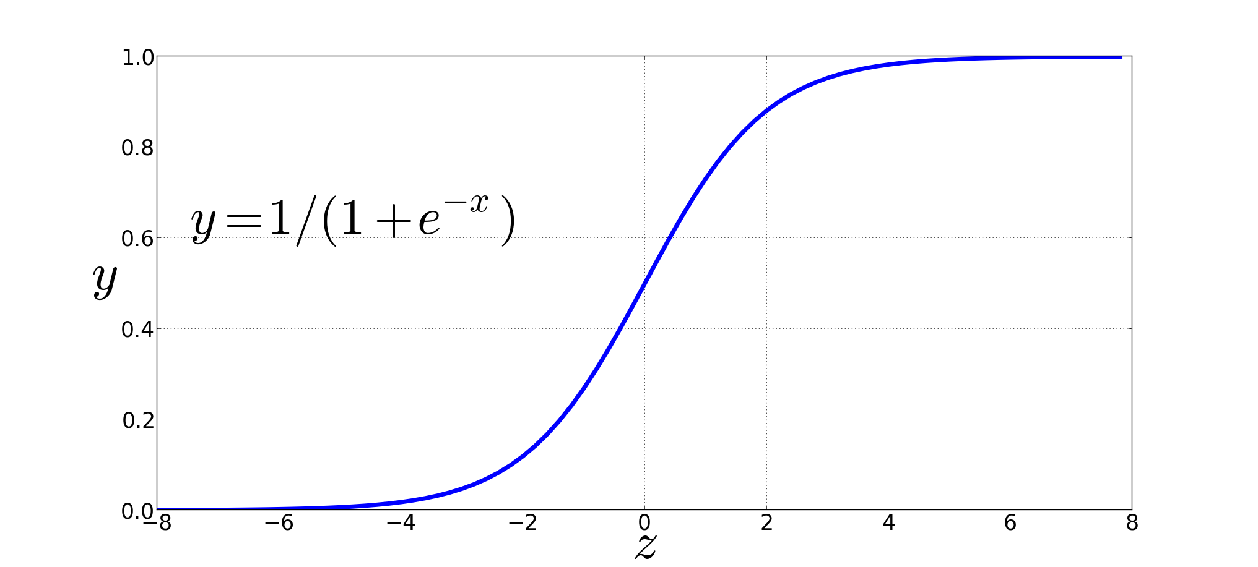
Turning dot product into a probability
The sigmoid lies between 0 and 1:

Slide 49
Turning dot products into probabilities
Sim(w,c) ≈ w ∙ c
To turn this into a probability
We'll use the sigmoid from logistic regression:
The sigmoid lies between 0 and 1:
Notes:
The dot product c · w is not a probability, it’s just a number ranging from −∞ to ∞ (since the elements in word2vec embeddings can be negative, the dot product can be negative). To turn the dot product into a probability, we’ll use the logistic or sigmoid function σ (x) from logistic regression
We model the probability that word c is a real context word for target word w as:
to make it a probability we’ll also need the total probability of the two possible events (c is a context word, and c isn’t a context word) to sum to 1. We thus estimate the probability that word c is not a real context word for w as:

Slide 50
How Skip-Gram Classifier computes P(+|w, c)
This is for one context word, but we have lots of context words.
We'll assume independence and just multiply them:
Notes:
This equation gives us the probability for one word, but there are many context words in the window. Skip-gram makes the simplifying assumption that all context words are independent, allowing us to just multiply their probabilities:

Slide 51
Skip-gram classifier: summary
A probabilistic classifier, given
a test target word w
its context window of L words c_{1:L}
Estimates probability that w occurs in this window based on similarity of w (embeddings) to c_{1:L} (embeddings).
To compute this, we just need embeddings for all the words.
Notes:
In summary, skip-gram trains a probabilistic classifier that, given a test target word w and its context window of L words c1:L, assigns a probability based on how similar this context window is to the target word. The probability is based on applying the logistic (sigmoid) function to the dot product of the embeddings of the target word with each context word. To compute this probability, we just need embeddings for each target word and context word in the vocabulary.

Slide 52
These embeddings we'll need: a set for w, a set for c
Notes:
Here's the intuition of parameters we’ll need. Skip-gram actually stores two embeddings for each word, one for the word as a target, and one for the word considered as context. Thus the parameters we need to learn are two matrices W and C, each containing an embedding for every one of the |V | words in the vocbulary
The embeddings learned by the skipgram model. The algorithm stores two embeddings for each word, the target embedding (sometimes called the input embedding) and the context embedding (sometimes called the output embedding). The parameter Theta that the algorithm learns is thus a matrix of 2|V| vectors, each of dimension d, formed by concatenating two matrices, the target embeddings W and the context+noise embeddings C.

Slide 53
Skip-Gram Training Data
Training sentence:
... lemon, a tablespoon of apricot jam a pinch ...
c1 c2 t c3 c4
Training data: input/output pairs centering on apricot
Asssume a +/- 2 word window

Slide 54
Learning skip gram Embeddings
..using a binary classifier (Logistic Regression)

Slide 55
Idea of Learning skip gram embeddings
The learning algorithm takes as input a corpus of text, and a chosen vocabulary size N.
It begins by assigning a random embedding vector for each of the N vocabulary words
It then proceeds to iteratively:
shift the embedding of each word w to be more like the embeddings of words that occur nearby in texts
and less like the embeddings of words that don’t occur nearby.

Slide 56
Skip-Gram Training
Training sentence:
... lemon, a tablespoon of apricot jam a pinch ...
c1 c2 t c3 c4
For each positive example, we'll create k negative examples.
Using noise words
Any random word that isn't t

Slide 57
Skip-Gram Training
Training sentence:
... lemon, a tablespoon of apricot jam a pinch ...
c1 c2 t c3 c4
k=2

Slide 58
Choosing noise words
Could pick w according to their unigram frequency P(w)
More common to chosen then according to p_{α}(w)
α= ¾ works well because it gives rare noise words slightly higher probability
To show this, imagine two events p(a)=.99 and p(b) = .01:

Slide 59
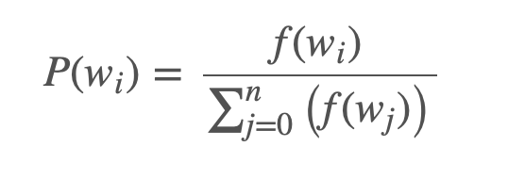
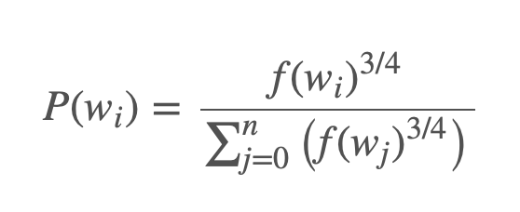
Selecting Negative Samples
Frequency based
Frequency of the word to the power of ¾.
Notes:
probability for picking the word “wi” would be equal to the number of times “wi” appears in the corpus, divided the total number of word occus in the corpus. N
increase the probability for less frequent words and decrease the probability for more frequent words.
When sampling the words for negative examples, it is recommended to do it proportionally to the frequency of the word to the power of ¾. Therefore, we avoid sampling the most frequent words in the sentence.

Slide 60
Again Word2vec: how to learn vectors
Given the set of positive and negative training instances, and an initial set of embedding vectors
The goal of learning is to adjust those word vectors such that we:
Maximize the similarity of the target word, context word pairs (w , c_{pos}) drawn from the positive data
Minimize the similarity of the (w , c_{neg}) pairs drawn from the negative data.
Notes:
Given the set of positive and negative training instances, and an initial set of embeddings, the goal of the learning algorithm is to adjust those embeddings to
• Maximize the similarity of the target word, context word pairs (w,cpos) drawn from the positive examples
• Minimize the similarity of the (w,cneg) pairs from the negative examples.

Slide 61
Loss function for one w with c_{pos} , c_{neg1} ...c_{negk}
Maximize the similarity of the target with the actual context words, and minimize the similarity of the target with the k negative sampled non-neighbor words.
Notes:
If we consider one word/context pair (w, cpos ) with its k noise words cneg1 ...cnegk , our goal is to maximize the similarity of the target with the actual context words, andn minimize the similarity of the target with the k negative sampled non-neighbor words. We can express these two goals as the following loss function L to be minimized (hence the −); here the first term expresses that we want the classifier to assign the real context word cpos a high probability of being a neighbor, and the second term expresses that we want to assign each of the noise words cnegi a high probability of being a non-neighbor, all multiplied because we assume independence:
If we substitute in our sigmoid of the dot product estimate for P, we want to maximize the dot product of the word with the actual context words, and minimize the dot products of the word with the k negative sampled non- neighbor words.
􏰼

Slide 62

Learning using gradient decent
Your adjustable parameters are:
Representation of your target vocabulary
Representation of your context vocabulary
You will learn two separate embedding matrices W and C
Can use W and throw away C, or merge them somehow
Notes:
make the positive pairs more likely
and the negative pairs less likely,
over the entire training set.

Slide 63
Intuition of one step of gradient descent
Notes:
Let's look at the intuition of one step of gradient descent. The skip-gram model tries to shift embeddings so the target embeddings (here for apricot) are closer to (have a higher dot product with) context embeddings for nearby words (here jam) and further from (lower dot product with) context embeddings for noise words that don’t occur nearby (here Tolstoy and matrix).

Slide 64
Summary: How to learn word2vec (skip-gram) embeddings
Start with V random 300-dimensional vectors as initial embeddings
Use logistic regression
Take a corpus and take pairs of words that co-occur as positive examples
Take pairs of words that don't co-occur as negative examples
Train the classifier to distinguish these by slowly adjusting all the embeddings to improve the classifier performance
Throw away the classifier code and keep the embeddings (weights of LR).
Details in 2nd paper by Mikolov’s.

Slide 65
Alternatively: Skip gram neural network model
Train a simple neural network with a single hidden layer
Use the learned weights as “word vectors” ( embeddings)
Note : This is a a huge neural network
No need to update all the weights while learning ( only the positive & negative examples)
Notes:
small window size of 2 just for the example. typical window size might be 5, meaning 5 words behind and 5 words ahead (10 in total
The word highlighted in blue is the input word.(target word) …now you need to predict the context

Slide 66
Skip gram neural network model
Source: (optional read)
http://mccormickml.com/2016/04/19/word2vec-tutorial-the-skip-gram-model/
http://mccormickml.com/2017/01/11/word2vec-tutorial-part-2-negative-sampling/

Slide 67
Skip gram neural network model
Train a simple neural network with a single hidden layer
Use the learned weights as “word vectors” ( embeddings)
Note : This is a a huge neural network
Notes:
mall window size of 2 just for the example. typical window size might be 5, meaning 5 words behind and 5 words ahead (10 in total
The word highlighted in blue is the input word.(target word) …now you need to predict the context

Slide 68
Skip-gram model example
Notes:
This notion of “neighbourhood” words is best described by considering a center (or current) word and a window of words around it. For example, if we consider the sentence “The quick brown fox jumped over the lazy dog”, and a window size of 2, we’d have the following pairs for the skip-gram model:

Slide 69
Notes:
10,000 vocab size eacg term represented as hot one encoder
In the example I gave, we had word vectors with 300 components, and a vocabulary of 10,000 words. Recall that the neural network had two weight matrices–a hidden layer and output layer. Both of these layers would have a weight matrix with 300 x 10,000 = 3 million weights each!
Image shows : 1” in the position corresponding to the word “ants”, and 0s in all of the other positions.
McCormick, C. (2016, April 19). Word2Vec Tutorial - The Skip-Gram Model. Retrieved from http://www.mccormickml.com
So, given a specific word in the middle of the sentence (the “context” word), we look at the words nearby and pick one at random (the “target” word). The network is going to tell us the probability for every word in the vocabulary of being the “target” word that we chose.

Slide 70
Notes:
10,000 vocab size each term represented as hot one encoder
Image shows : 1” in the position corresponding to the word “ants”, and 0s in all of the other positions.
McCormick, C. (2016, April 19). Word2Vec Tutorial - The Skip-Gram Model. Retrieved from http://www.mccormickml.com

Slide 71
Goal is just to learn this hidden layer weight matrix
Notes:
10,000 vocab size each term represented as hot one encoder
Image shows : 1” in the position corresponding to the word “ants”, and 0s in all of the other positions.
McCormick, C. (2016, April 19). Word2Vec Tutorial - The Skip-Gram Model. Retrieved from http://www.mccormickml.com

Slide 72
Learning word vectors with 300 features.
So the hidden layer is going to be represented by a weight matrix with 10,000 rows (one for every word in our vocabulary) and 300 columns (one for every hidden neuron).
Notes:
If we use our “standard” representation of 300 features for each word, then the hidden layer of the network will be represented by a weight matrix of dimension (10,000 x 300). These are the weights we are interested in learning. We don’t care about the output of the network.
It’s sort of a trick: we train a network for doing something, but we actually don’t care about the output of this supervised learning problem. Instead, we use it to learn the parameters (the weights) within the network.
The number of features is a "hyper parameter" that you would just have to tune to your application (that is, try different values and see what yields the best results).

Slide 73
Does this really work?
What is the intuition behind all this?
If two words are appearing in similar context (output similar results)
The network will output similar predictions for these words is if the vectors are similar.
Example:
Network when sees the word “orange” then it outputs juice (because “juice” appears “in the neighborhood”
But also the word “apple” & “juice” appear closely in corpus is close by, is when “apple” and “orange” are similar.
Then, finally, the network learns that “orange” and “apple” are similar vectors and predicts “juice” when it sees either of them.
Notes:
If two different words have very similar “contexts” (that is, what words are likely to appear around them), then our model needs to output very similar results for these two words. And one way for the network to output similar context predictions for these two words is if the word vectors are similar. So, if two words have similar contexts, then our network is motivated to learn similar word vectors for these two words!
for two words to have similar contexts? I think you could expect that synonyms like “intelligent” and “smart” would have very similar contexts. Or that words that are related, like “engine” and “transmission”, would probably have similar contexts as well.

Slide 74
Example of output
Notes:
The intuition behind all this is that if two words are appearing around each other often, then the model will output similar results for these words. One way for the network to output similar predictions for these words is if the vectors are similar.
So think about the network learning that when it sees the word “orange” then the word “juice” is also “in the neighborhood”. One way to predict that also with the word “apple” the word “juice” is close by, is when “apple” and “orange” are similar.
Then, finally, the network learns that “orange” and “apple” are similar vectors and predicts “juice” when it sees either of them.

Slide 75
Negative subsampling: Variations of skip gram models
To reduce computations and improve quality of word vectors
Subsampling frequent words
“Negative Sampling”, which causes each training sample to update only a small percentage of the model’s weights.
Details in 2nd paper by Mikolov’s.
Notes:
One other issue with this model is related to how to choose the context word. In fact, if we pick it randomly we might end up picking the most frequent words (i.e., “the”, “a”, “of”, …). In this case, the network doesn’t learn that much, as the training dataset doesn’t contain “interesting” word to learn.

Slide 76
Negative sampling
Instead of updating all the weights, only modify a small percentage of the weights
Randomly select just a small number of “negative” words (let’s say 5) to update the weights for.
A “negative” word is one for which we want the network to output a 0 for).
We will also still update the weights for our “positive” word
For a small dataset, the number of negative examples k is within a range of 5 to 20, while 2 to 5 for a large dataset.
Notes:
The paper says that selecting 5-20 words works well for smaller datasets, and you can get away with only 2-5 words for large datasets.

Slide 77
Quiz
Output layer of our model has a weight matrix that’s 300 x 10,000.
So we will just be updating the weights for our positive word (“juice”), plus the weights for 5 other words that we want to output 0.
What is the total weights to be updated ? What is the % of the original weight updates?
Notes:
In the hidden layer, only the weights for the input word are updated (this is true whether you’re using Negative Sampling or not).
Instead of training all 10,000 of them on every iteration, we are only going to use (k+1) of them. (k total negative examples, one positive example).
That’s a total of 6 output neurons, and 1,800 weight values total. That’s only 0.06% ( 1800 /

Slide 78
More on Word Embeddings

Slide 79
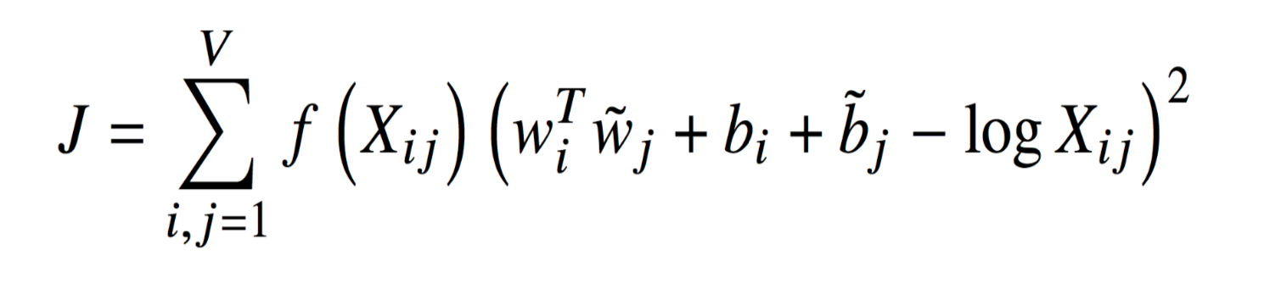
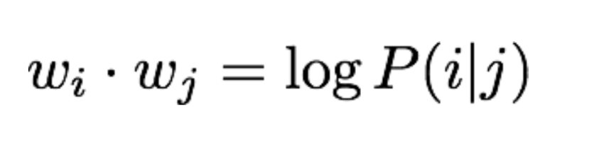
GloVe [Pennington et al., EMNLP 2014]
Counting the number of times, a word “i” appears in the context of “j”. ( Predicts words given co-occurrence matrix Xij)
Leverages global statistical information (co-occurrence matrix), and produce a vector space with meaningful sub-structure
Notes:
Populating the co-occurance matrix requires a single pass through the entire
corpus to collect the statistics. For large corpora, this pass can be computationally expensive, but it is a one-time up-front cost.
O
-
O
C
C
uGloVe

Slide 80
GloVe [Pennington et al., EMNLP 2014]
Counting the number of times, a word “i” appears in the context of “j”. ( Predicts words given co-occurrence matrix Xij)
J minimize the squared error of the logarithms
f(X_{ij})=0 for X_{ij}=0
(only non-zero elements are trained)
word i appearing in the context of word j
Leverages global statistical information (co-occurrence matrix), and produce a vector space with meaningful sub-structure
Notes:
Populating the co-occurance matrix requires a single pass through the entire
corpus to collect the statistics. For large corpora, this pass can be computationally expensive, but it is a one-time up-front cost.
Another very widely used static embedding model is GloVe (Pennington et al.,
2014), short for Global Vectors, because the model is based on capturing global
corpus statistics. GloVe is based on ratios of probabilities from the word-word cooccurrence
matrix, combining the intuitions of count-based models like PPMI while
also capturing the linear structures used by methods like word2vec.
It turns out that dense embeddings like word2vec actually have an elegant mathematical
relationship with sparse embeddings like PPMI, in which word2vec can be
seen as implicitly optimizing a shifted version of a PPMI matrix (Levy and Goldberg,
2014c).
O
-
O
C
C
uGloVe

Slide 81
GloVe [Pennington et al., EMNLP 2014]
Fast Training
Scalable to huge corpora
Good performance even with small corpus and small vectors
Compared to direct prediction methods: skip-grams
do not take advantage of statistics, still work and scale well

Slide 82
Pretrained models word2vec models
You can find pre-trained models on huge corpora
Examples:
http://nlp.stanford.edu/projects/glove/
http://code.google.com/archive/p/word2vec/
Another approach by Facebook “Fasttext” (Bojanowski 2016) using skip-grams(faster to train) but with n-grams not whole words http://arxiv.org/abs/1607.04606
You can load pretrained embeddings to initialize your NN weights.
Notes:
An extension of word2vec, fasttext
(Bojanowski et al., 2017), addresses a problem with word2vec as we have presented
it so far: it has no good way to deal with unknown words—words that appear in
a test corpus but were unseen in the training corpus. A related problem is word
sparsity, such as in languages with rich morphology, where some of the many forms
for each noun and verb may only occur rarely. Fasttext deals with these problems
by using subword models, representing each word as itself plus a bag of constituent
n-grams, with special boundary symbols < and > added to each word.

Slide 83





Dense embeddings you can download!
Word2vec (Mikolov et al.)
https://code.google.com/archive/p/word2vec/
Fasttext http://www.fasttext.cc/
Glove (Pennington, Socher, Manning)
http://nlp.stanford.edu/projects/glove/

Slide 84
How to train your own (Lecture Demo)
Why: specific domain (use case – specific corpora)
Gensim great package to train your word2vec
For vector space modelling & topic modelling
Example learn word-embeddings on food reviews http://www.kaggle.com/snap/amazon-fine-food-reviews
Code: http://localhost:8888/tree/Text-Mining-with-Machine-Learning-and-Python-master/Section5
Notes:
The input here is of course the list of lists of tokens and 3 main parameters the minimum counts the
window and the size the size determining the number of dimensions in your word.
Embeddings the window being the size of the moving window.
So of the variable context and min counts being the minimum number of occurrences a certain word needs
to have before it gets apprehended in the final corpus.

Slide 85
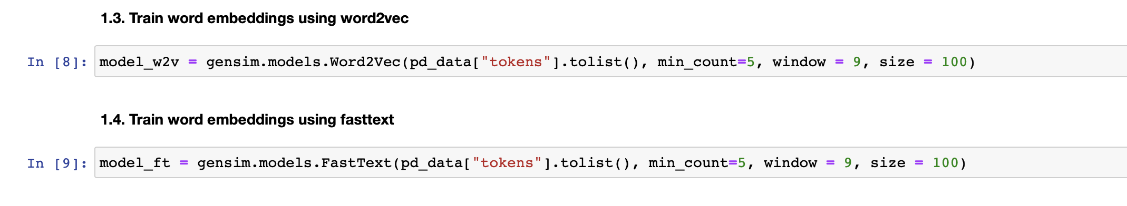
Class Demo on Amazon food reviews
Window= size of the moving window
Size= dimension of the embedding
Notes:
The input here is of course the list of lists of tokens and 3 main parameters the minimum counts the
window and the size the size determining the number of dimensions in your word.
Embeddings the window being the size of the moving window.
So of the variable context and min counts being the minimum number of occurrences a certain word needs
to have before it gets apprehended in the final corpus.

Slide 86
Visualizing word embeddings
Problem of dimensionality reduction
Good visualization is using t-SNE http://lvdmaaten.github.io/tsne/
Check the visualization plot for the learned embeddings : http://localhost:8888/view/Text-Mining-with-Machine-Learning-and-Python-master/Section5/plot.html
Other approaches include sentence2vec and document2vec emoji2vec

Slide 87
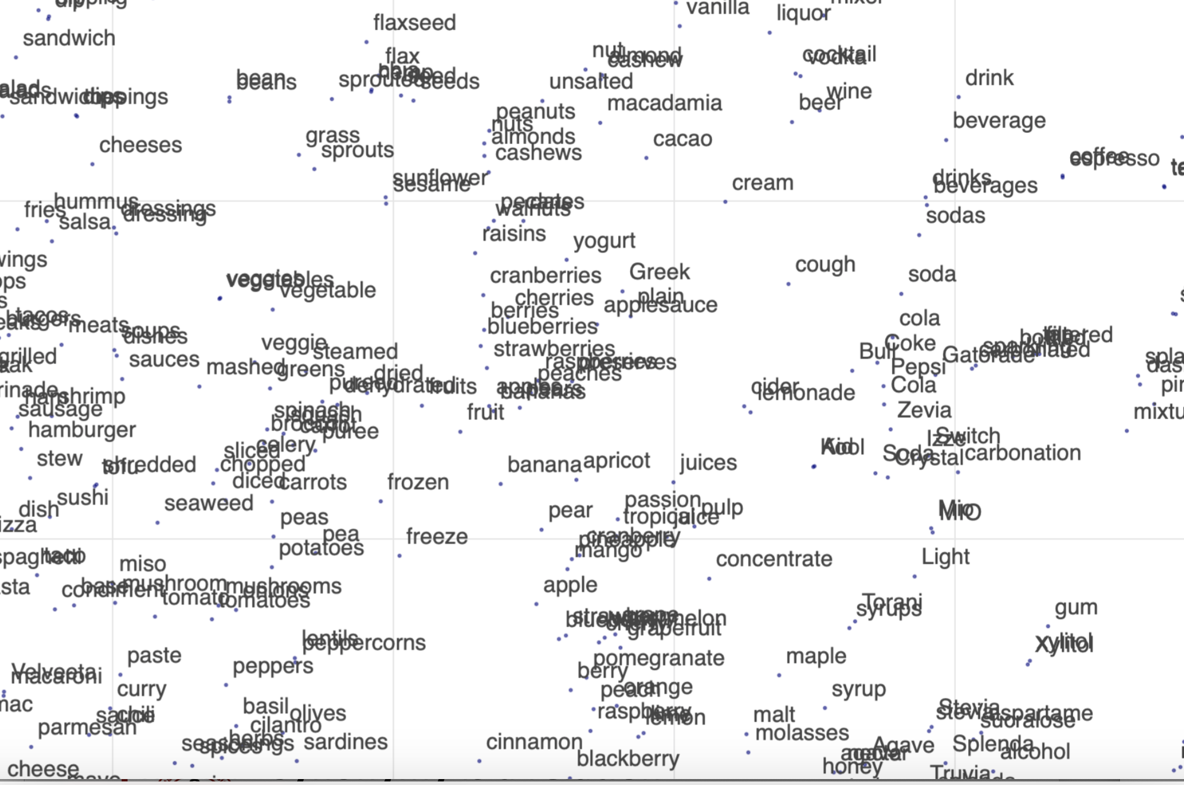

Slide 88
Take away
Embeddings = vector models of meaning
More fine-grained than just a string or index
Especially good at modeling similarity/analogy
Just download them and use cosines!!
Can use sparse models (tf-idf) or dense models (word2vec, GLoVE)
Useful in practice but know they encode cultural stereotypes (Bias)

Slide 89
Note on Static Embeddings
Word2vec, Glove & fasttext are static embeddings
i.e, it learns one fixed embedding for each word in the
embeddings vocabulary.
Later methods for learning dynamic contextual embeddings like the popular family of BERT representations, in which the vector
for each word is different in different contexts.

Slide 90
History of biased framings of women
Garg, Nikhil, Schiebinger, Londa, Jurafsky, Dan, and Zou, James (2018). Word embeddings quantify 100 years of gender and ethnic stereotypes. Proceedings of the National Academy of Sciences, 115(16), E3635–E3644
Embeddings for competence adjectives are biased toward men
Smart, wise, brilliant, intelligent, resourceful, thoughtful, logical, etc.
This bias is slowly decreasing

Slide 91
Changes in framing: adjectives associated with Chinese
Garg, Nikhil, Schiebinger, Londa, Jurafsky, Dan, and Zou, James (2018). Word embeddings quantify 100 years of gender and ethnic stereotypes. Proceedings of the National Academy of Sciences, 115(16), E3635–E3644

Slide 92
Resources
Chapter 6: Vector Semantics and Embeddings , Speech and Language Processing, Jurafsky&Martin, 3r edition draft
Supplementary material Stanford NLP & DL lecture 1&2 ( nice slides & notes) + Gensim example on GloVe embeddings visualization & analogy
Sources used: Lecture notes: Part I – Part II

Slide 93
Week 8 Lab Material
NLTK/Scikit-learn don’t support word-embeddings
Gensim allows user to train word2vec and doc2vec from any custom text collection
Gensim provides with word2vec model pre-trained on Google news corpus ( Can use genism to visualize GloVe embeddings from gensim.scripts.glove2word2vec import glove2word2vec )
Getting stated with Tensorflow:
Introduction to word-embedding ( training your word embedding on a small sentiment classification task) – material and prerecording available
Skip-gram and Negative Sampling (optional for self-study)
Notes:
Material

Slide 94
Next
Traditional NLP (up till 2012) – things have been revolutionized with the use of NN
Sequence to Sequence Models:
RNN
LSTM
Applications:
Text Generation
Machine Translation

Slide 95
Questions?

Slide 96
Thank you!

